Slide 1
MINISTRY OF ROAD AND TRANSPORT DEVELOPMENT
GOVERNMENT OF MONGOLIA

Slide 2
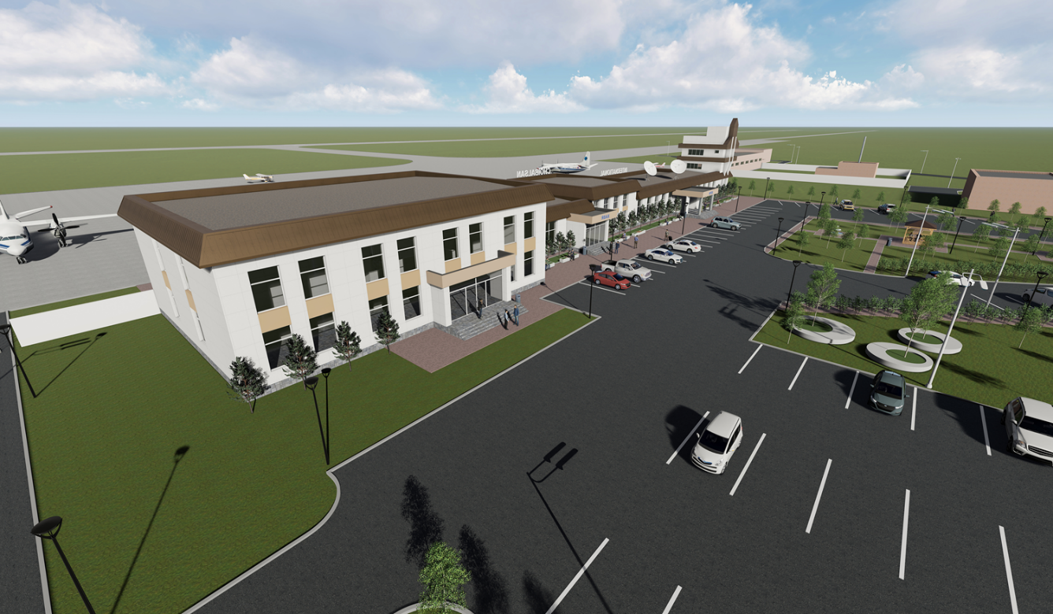
Upgrading the capability of “Choibalsan” airport located in Dornod province to 4C aerodrome reference code in compliance with ICAO standard project
Increase the role and responsibility of the state in terms of society and economy, stabilize air transport services in remote areas, and expand international air connections;
Implementation of liberalization of international air transport, creation of competition, support for tourism development;
It will support local development, increase jobs, improve people's livelihoods, and reduce migration.
300
PASSENGERS PER HOUR.
THE RUNWAY WILL BE CAPABLE OF DELIVERING 4C TYPE AIRCRAFT BOEING 737-800.
Investment
28 MILLION USD /APPROX./
FEASIBILITY STUDY
DESIGN
LAND PERMIT
ENVIRONMENTAL ASSESSMENT
FINANCING SOLUTION

Slide 3
Upgrading “Gurvansaikhan” airport located in “Umnugovi” province to 4D aerodrome reference code, Passenger terminal building in compliance with ICAO standard project
Project name
The as-built drawing of the aerodrome expansion and navigation equipment installation have been prepared by “EZT” LLC and approved by the Road and Transport Development Center in 2020.
The comprehensive as-built drawing of the passenger terminal building capable of accommodating 550 passengers per hour, Control tower, and other engineering facilities has been prepared by “Erkhes Construction” LLC and approved by the Construction Development Center in 2023.
The project to increase the capacity and improve the use of the "Gurvansaikhan" airport has been newly prepared and included in the "List of State Property Concession Items" approved by the appendix of the Government Resolution No. 317 of 2013.
It was added to the "List of State Property Concession Items" approved by Government Resolution No. 253 dated 07.05.2023 as an appendix to Resolution No. 317 of 2013.
Progress
Solutions
Development of a technical task project related to the competitive selection process for awarding airport concessions.
Take measures to prepare for the international open bidding process for concessions.

Slide 4
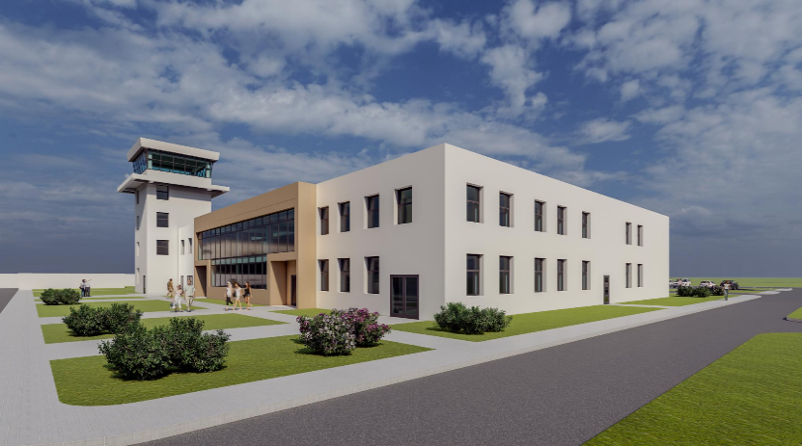
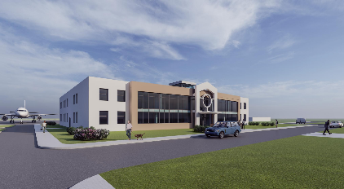
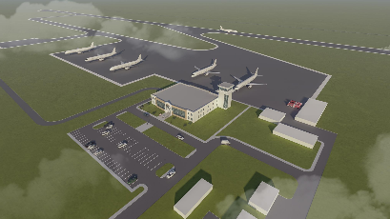
Upgrading the capability of “Deglii tsagaan” airport located in Uvs province to 4C aerodrome reference code in compliance with ICAO standart project
Increase the role and responsibility of the state in terms of society and economy, stabilize air transport services in remote areas, and expand international air connections;
Implementation of liberalization of international air transport, creation of competition, support for tourism development;
It will support local development, increase jobs, improve people's livelihoods, and reduce migration.
300
PASSENGERS PER HOUR.
THE RUNWAY WILL BE CAPABLE OF DELIVERING 4D TYPE AIRCRAFT BOEING 737-800.
Investment
19 MILLION USD /APPROX./
FEASIBILITY STUDY
DESIGN
LAND PERMIT
ENVIRONMENTAL ASSESSMENT
FINANCING SOLUTION

Slide 5
Upgrading the capability of “Deglii tsagaan” airport located in Uvs province to 4C aerodrome reference code in compliance with ICAO standart project
Project name
The as-built drawing of the aerodrome expansion has been carried out by “Avarga Zam” LLC and expertized by the Construction Development Center in 2020;
The as-built drawing of the Passenger terminal building, renovation, and other facilities has been prepared by “Nextstep Engineering” LLC and expertized by the appropriate Authority in 2022;
The project to increase the capacity and improve the use of the “Choibalsan” airport, which was approved by the appendix of the Government’s Resolution No. 317 of 2013, has been updated and prepared the economic efficiency calculation, research, and presentation to be added to the "List of State Property Concession Items";
It was added to the "List of State Property Concession Items" approved by Government Resolution No. 253 dated 07.05.2023 as an appendix to Resolution No. 317 of 2013.
Progress
Solutions
Development of a technical task project related to the competitive selection process for awarding airport concessions.
Take measures to prepare for the international open bidding process for concessions.

Slide 6
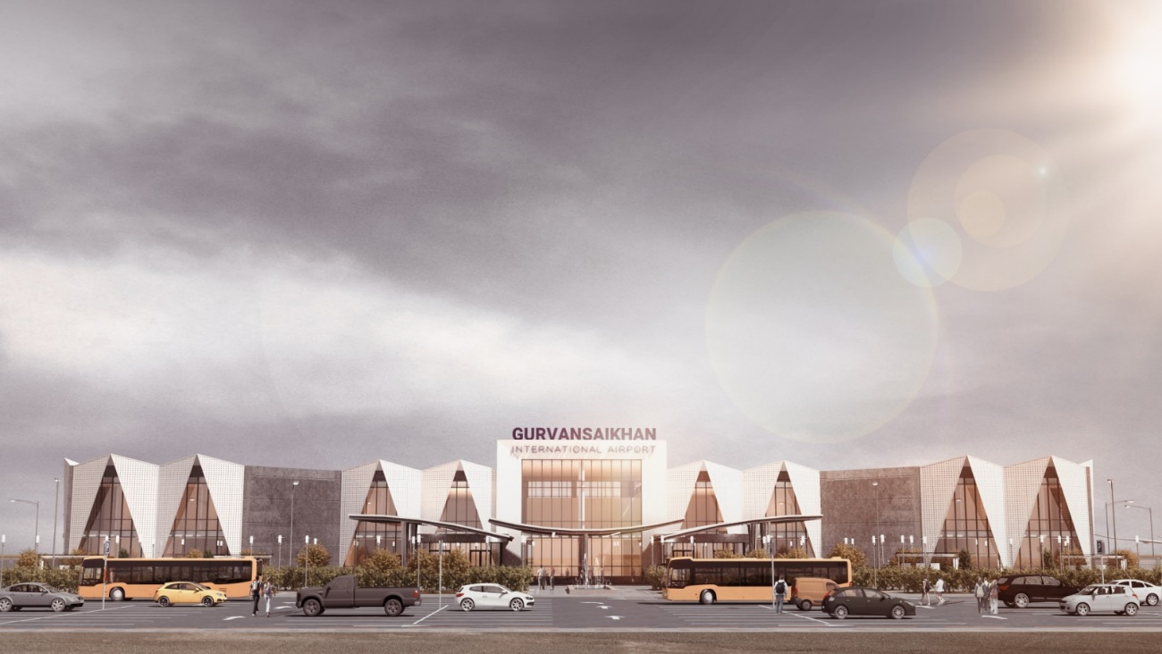
Upgrading the capability of “Gurvansaikhan” airport located in “Umnugovi” province to 4D aerodrome reference code in compliance with ICAO standart project
Increase the role and responsibility of the state in terms of society and economy, stabilize air transport services in remote areas, and expand international air connections;
Implementation of liberalization of international air transport, creation of competition, support for tourism development;
It will support local development, increase jobs, improve people's livelihoods, and reduce migration.
550
PASSENGERS PER HOUR.
THE RUNWAY WILL BE CAPABLE OF DELIVERING 4D TYPE AIRCRAFT BOEING 767-300.
Investment
49 MILLION USD /APPROX./
FEASIBILITY STUDY
DESIGN
LAND PERMIT
ENVIRONMENTAL ASSESSMENT
FINANCING SOLUTION

Slide 7
Upgrading “Gurvansaikhan” airport located in “Umnugovi” province to 4D aerodrome reference code, Passenger terminal building in compliance with ICAO standard project
Project name
The as-built drawing of the aerodrome expansion and navigation equipment installation have been prepared by “EZT” LLC and approved by the Road and Transport Development Center in 2020.
The comprehensive as-built drawing of the passenger terminal building capable of accommodating 550 passengers per hour, Control tower, and other engineering facilities has been prepared by “Erkhes Construction” LLC and approved by the Construction Development Center in 2023.
The project to increase the capacity and improve the use of the "Gurvansaikhan" airport has been newly prepared and included in the "List of State Property Concession Items" approved by the appendix of the Government Resolution No. 317 of 2013.
It was added to the "List of State Property Concession Items" approved by Government Resolution No. 253 dated 07.05.2023 as an appendix to Resolution No. 317 of 2013.
Progress
Solutions
Development of a technical task project related to the competitive selection process for awarding airport concessions.
Take measures to prepare for the international open bidding process for concessions.

Slide 8
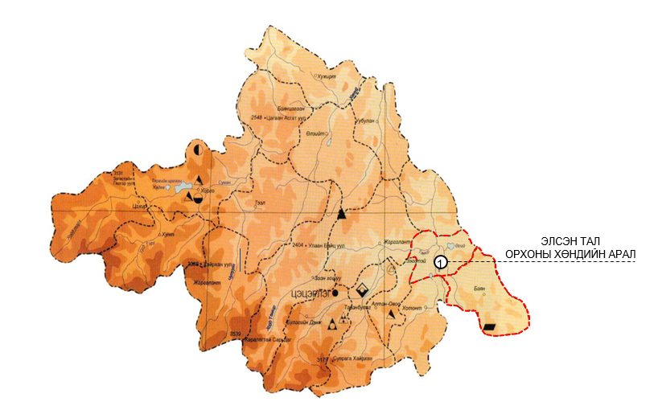
Establishing the new airport with 4E aerodrome reference code and passenger terminal complex in “New Kharkhorum” in compliance with ICAO standart project
Increase the role and responsibility of the state in terms of society and economy, stabilize air transport services in remote areas, and expand international air connections;
Implementation of liberalization of international air transport, creation of competition, support for tourism development;
It will support local development, increase jobs, improve people's livelihoods, and reduce migration.
PASSENGER TARMINAL BUILDING WILL ACCOMMODATE 800 PASSENGERS PER HOUR.
THE RUNWAY WILL BE CAPABLE OF DELIVERING 4D TYPE AIRCRAFT BOEING 747-400.
Investment
Required investment of the project will be determined at the as-built drawing stage
FEASIBILITY STUDY
DESIGN
LAND PERMIT
ENVIRONMENTAL ASSESSMENT
FINANCING SOLUTION

Slide 9
Upgrading “New Kharkhorum” airport located in “Orkhon Valley” province to 4D aerodrome reference code, Passenger terminal building in compliance with ICAO standard project
Project name
The as-built drawing of the aerodrome expansion and navigation equipment installation have been prepared by “EZT” LLC and approved by the Road and Transport Development Center in 2020.
The comprehensive as-built drawing of the passenger terminal building capable of accommodating 550 passengers per hour, Control tower, and other engineering facilities has been prepared by “Erkhes Construction” LLC and approved by the Construction Development Center in 2023.
The project to increase the capacity and improve the use of the "Gurvansaikhan" airport has been newly prepared and included in the "List of State Property Concession Items" approved by the appendix of the Government Resolution No. 317 of 2013.
It was added to the "List of State Property Concession Items" approved by Government Resolution No. 253 dated 07.05.2023 as an appendix to Resolution No. 317 of 2013.
Progress
Solutions
Place an automatic weather station at the location of the airport to determine the accurate prevailing wind direction,
To carry out feasibility study and other related as-built drawing of the project,
To solve the required investment for project development.

Slide 10
Upgrading the capability of “Khovd” airport located in “Khovd” province to 4C aerodrome reference code
Increase the role and responsibility of the state in terms of society and economy, stabilize air transport services in remote areas, and expand international air connections;
Implementation of liberalization of international air transport, creation of competition, support for tourism development;
It will support local development, increase jobs, improve people's livelihoods, and reduce migration.
300
PASSENGERS PER HOUR.
THE RUNWAY WILL BE CAPABLE OF DELIVERING 4D TYPE AIRCRAFT BOEING 737-800.
Investment
20 MILLION USD /APPROX./
FEASIBILITY STUDY
DESIGN
LAND PERMIT
ENVIRONMENTAL ASSESSMENT
FINANCING SOLUTION

Slide 11
Upgrading the capability of “Khovd” airport located in “Khovd” province to 4C aerodrome reference code in compliance with ICAO standards project
Project name
The as-built drawing of the aerodrome expansion has been carried out by “EZT” LLC and expertized by the Road and Transport Development Center in 2018.
The as-built drawing of the Passenger terminal building and other building-related facilities have been prepared by “Altain Gazriin Huch” LLC and expertized by the Construction Development Center in 2020.
The project to increase the capacity and improve the use of the “Khovd" airport has been prepared by the Ministry of Road and Transport Development, the Ministry of Road and Transport Development, and the Ministry of Economy It was submitted to the Ministry of Government Development electronically and presented at the meeting of the Government on July 5, 2023, and it was approved for inclusion in the "List of State Property Concession Items" approved by the Appendix to Government Resolution No. 317 of 2013.
It was added to the "List of State Property Concession Items" approved by Government Resolution No. 253 dated 07.05.2023 as an Appendix to Resolution No. 317 of 2013.
Progress
Solutions
Development of a technical task project related to the competitive selection process for awarding airport concessions.
Take measures to prepare for the international open bidding process for concessions.

Slide 12
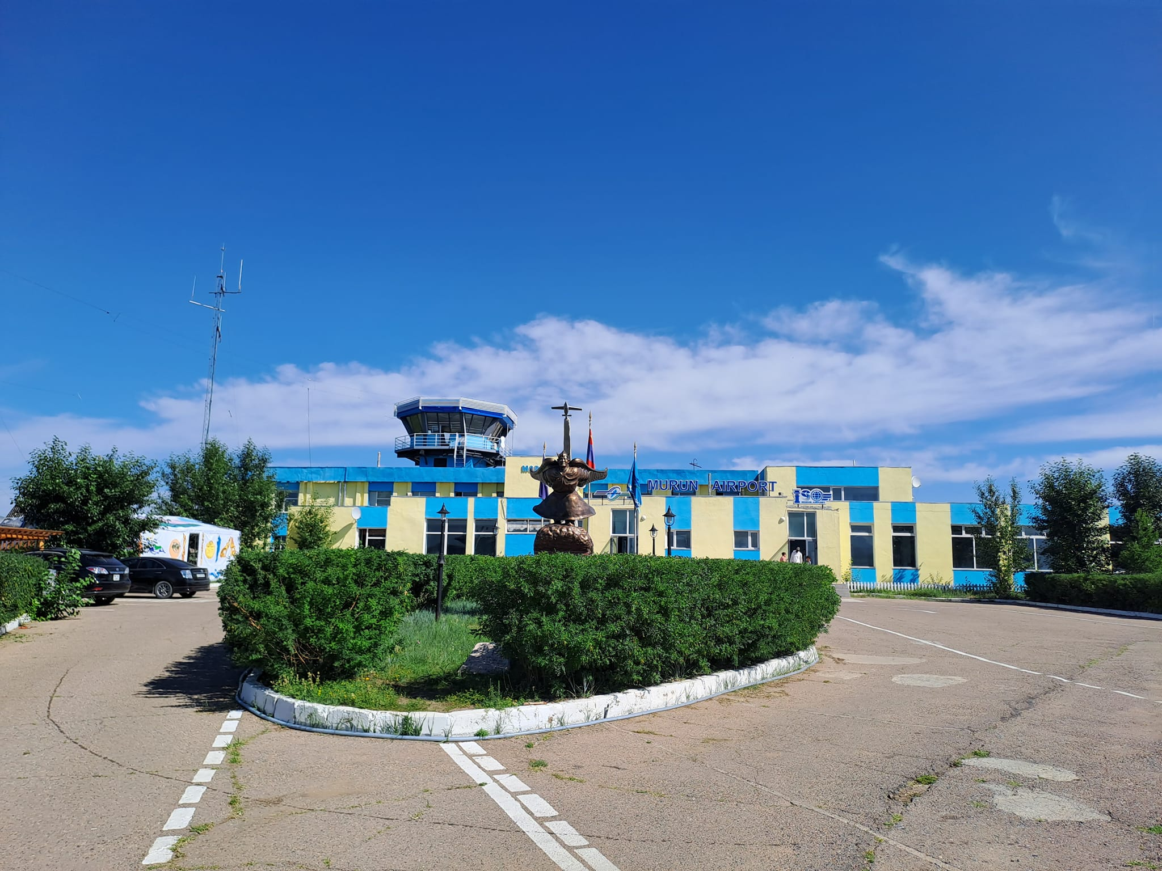
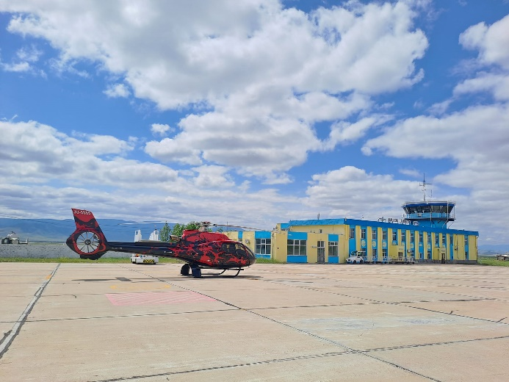
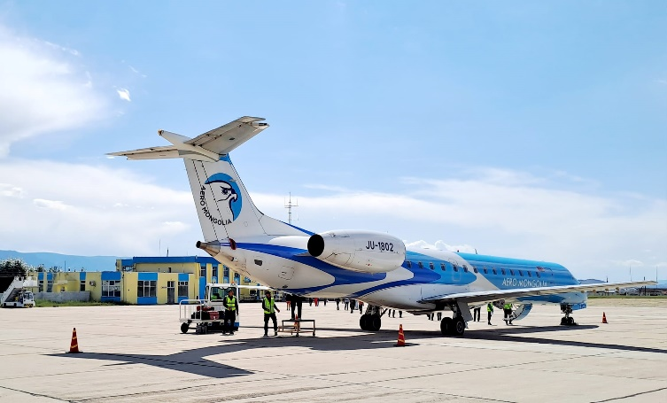
Upgrading the capability of “Murun” airport located in “Khuvsgul” province to 4C aerodrome reference code in compliance with ICAO standart project
Increase the role and responsibility of the state in terms of society and economy, stabilize air transport services in remote areas, and expand international air connections;
Implementation of liberalization of international air transport, creation of competition, support for tourism development;
It will support local development, increase jobs, improve people's livelihoods, and reduce migration.
300
PASSENGERS PER HOUR.
THE RUNWAY WILL BE CAPABLE OF DELIVERING 4D TYPE AIRCRAFT BOEING 737-800.
Investment
6.8 MILLION USD /APPROX./
FEASIBILITY STUDY
DESIGN
LAND PERMIT
ENVIRONMENTAL ASSESSMENT
FINANCING SOLUTION

Slide 13
Upgrading the capability of “Murun” airport located in “Khuvsgul” province to 4C aerodrome reference code in compliance with ICAO standart project
Project name
The as-built drawing of the aerodrome expansion has been prepared by “EZT” LLC and expertized by the appropriate Authority in 2019.
The project to increase the capacity and improve the use of the “Murun” airport, which was approved by the annex of the Government’s Resolution No. 317 of 2013, has been updated, and the economic efficiency calculation, research, and presentation to be added to the "List of State Property Concession Items”;
It was added to the "List of State Property Concession Items" approved by Government Resolution No. 253 dated 07.05.2023 as an appendix to Resolution No. 317 of 2013.
Progress
Solutions
Development of a technical task project related to the competitive selection process for awarding airport concessions.
Take measures to prepare for the international open bidding process for concessions.

Slide 14
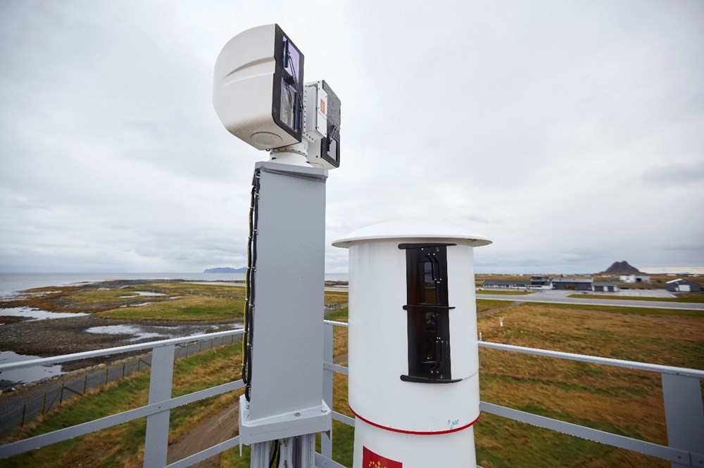
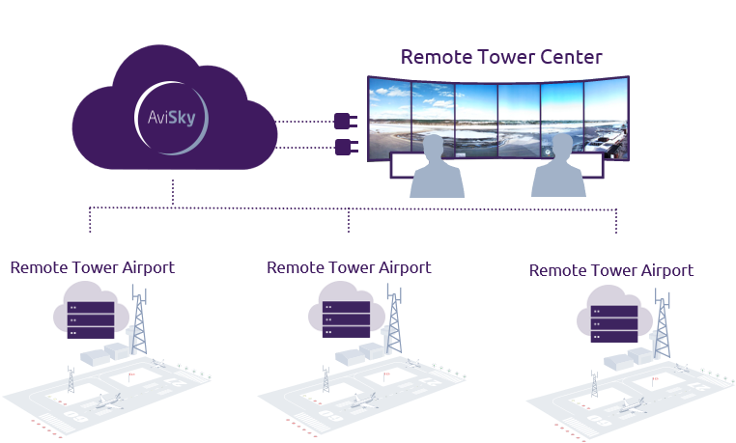
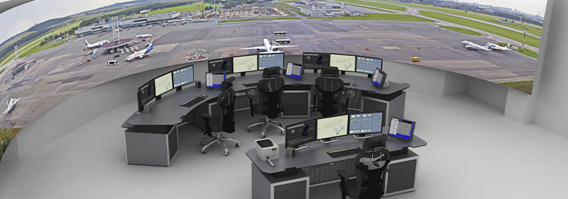
Establishment of a remote air traffic control center
Traffic management of local airports will be conducted by the center;
Reserve workplaces will be established in the center to be used in the event of force majeure at "Chingis Khan" and "Buyant-Ukhaa";
Aerodrome air traffic control training will be organized in the center.
The remote air traffic control center, the standard requirements of the International Civil Aviation Organization (ICAO) will be met, flight safety will be improved, the air traffic control services of airports will be available, and the shortage of human resources at remote airports will be eliminated.
Investment
Feasibility study – 0.15 million USD /Approx./
Construction – 8.5 million USD /Approx./
FEASIBILITY STUDY
DESIGN
LAND PERMIT
ENVIRONMENTAL ASSESSMENT
FINANCING SOLUTION

Slide 15
Project name
Establishment of a remote air traffic control center
The air traffic remote control center will be established in the Jargalant complex under the CAA in Ulaanbaatar, and a preliminary feasibility study has been developed.
With the investment of 2024, it is planned to provide preparatory work such as feasibility study and environmental assessment.
It was presented at the Road and Transport Industry Investment Conference 2023 to address the investment in the construction of a remote air traffic control center.
Progress
Solutions
Address funding for the Remote Air Traffic Control Center.
/state budget investment, foreign concessional loans, aid, state and private sector partnerships/

Slide 16
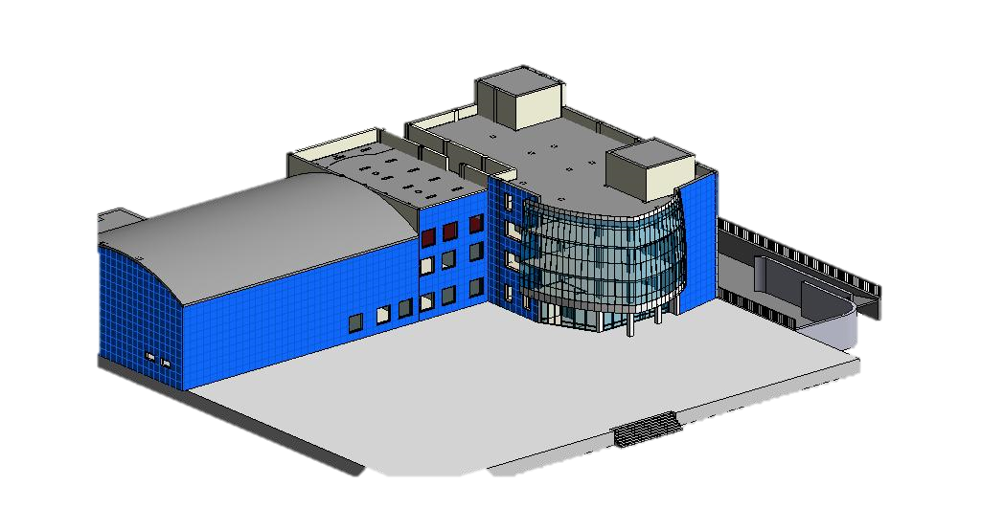
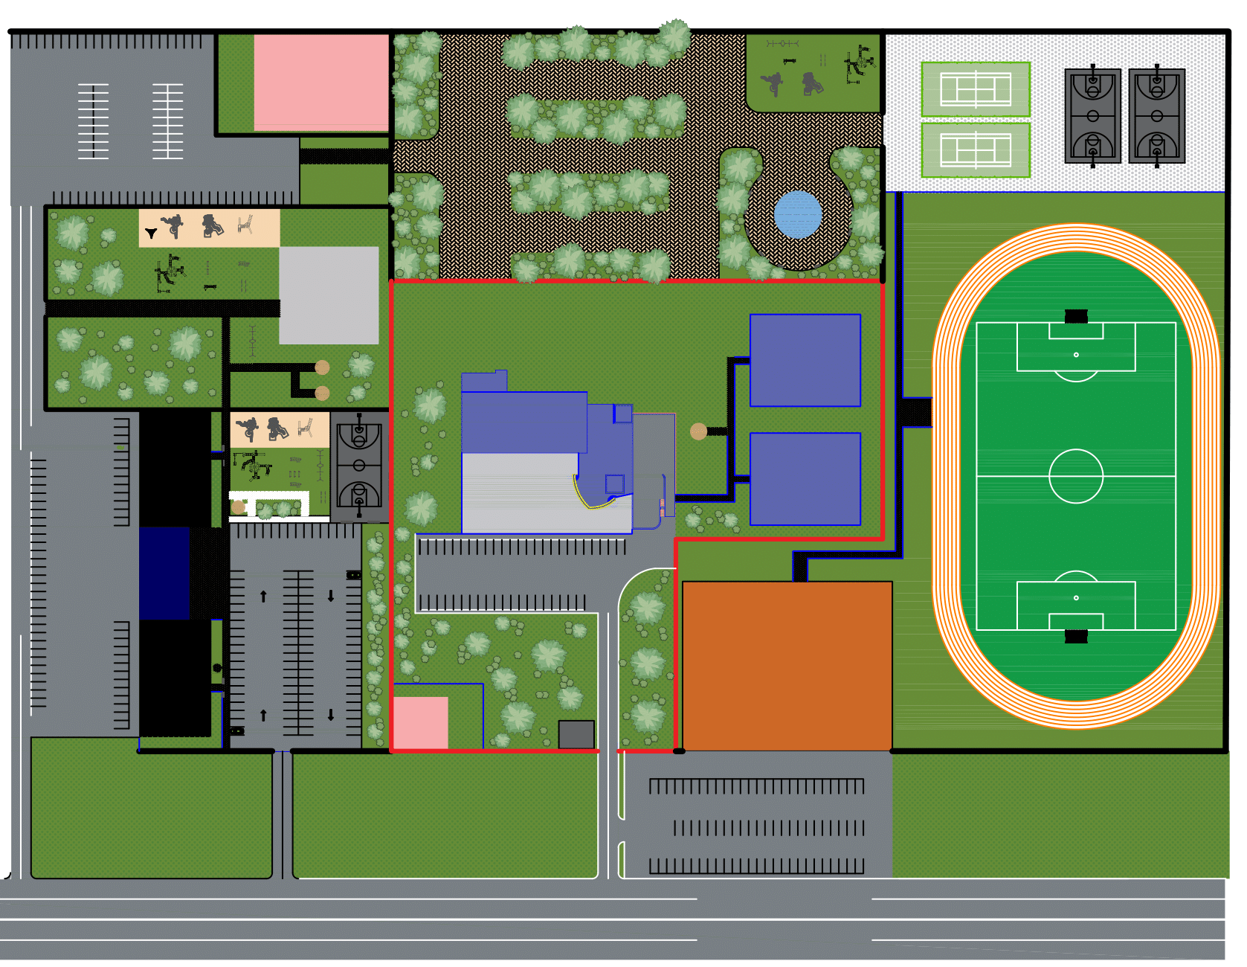
Establishing a second area control center
With the establishment of the second regional air traffic control center, the standard requirements of the International Civil Aviation Organization (ICAO) will be met, flight safety will improve
There are many advantages of increasing airspace capacity of Mongolia, increasing the number of flights, increasing navigation revenue, increasing new jobs, and reducing concentration.
The second area control center will meet the International Civil Aviation Organization (ICAO) standards, improve flight safety, increase the number of flights passing through Mongolia's airspace, and increase the revenue from navigation fees.
Investment
Feasibility study – 0.3 million USD /Approx./
Construction – 28 million USD /Approx./
6
Second area control center
Sport complex
100 family apartments
Kindergarten
Power substation
Park
Checkpoint
4
3
1
5
7
2
BUILDING AREA
3 hectares
FEASIBILITY STUDY
DESIGN
LAND PERMIT
ENVIRONMENTAL ASSESSMENT
FINANCING SOLUTION

Slide 17
Project name
Establishing a second area control center
34 of the list of projects and measures that require development of technical and economic basis and design of Annex 5, 2.4 of the five-year development direction of Mongolia in 2021-2025, approved by Parliament Resolution No. 23 dated August 28, 2020 "Feasibility study and design development for the establishment of a regional air traffic reserve center" in 42 of the list of projects and measures that need to be resolved in Annex 6, 2.3 of the Funding Sources "Establishment of the Second area control center" budget It was approved to be built with a 30 million USD.
The decision to establish the second area control center in Sainshand, Dornogovi Province was made by the CAA in 2023, and a preliminary feasibility study was developed after receiving local approval for the construction site.
With the investment of 2024, it is planned to provide preparatory work such as feasibility study and environmental assessment.
It was presented at the Road and Transport Industry Investment Forum 2023 to address investment in the construction of a second area control center.
Progress
Solutions
Address funding for a second area control center.
/state budget investment, foreign concessional loans, aid, state and private sector partnerships/

