Slide 1
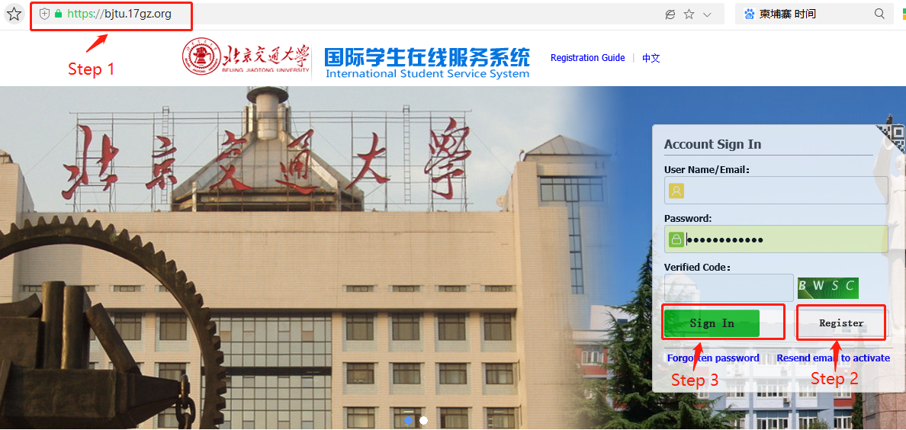

Slide 2
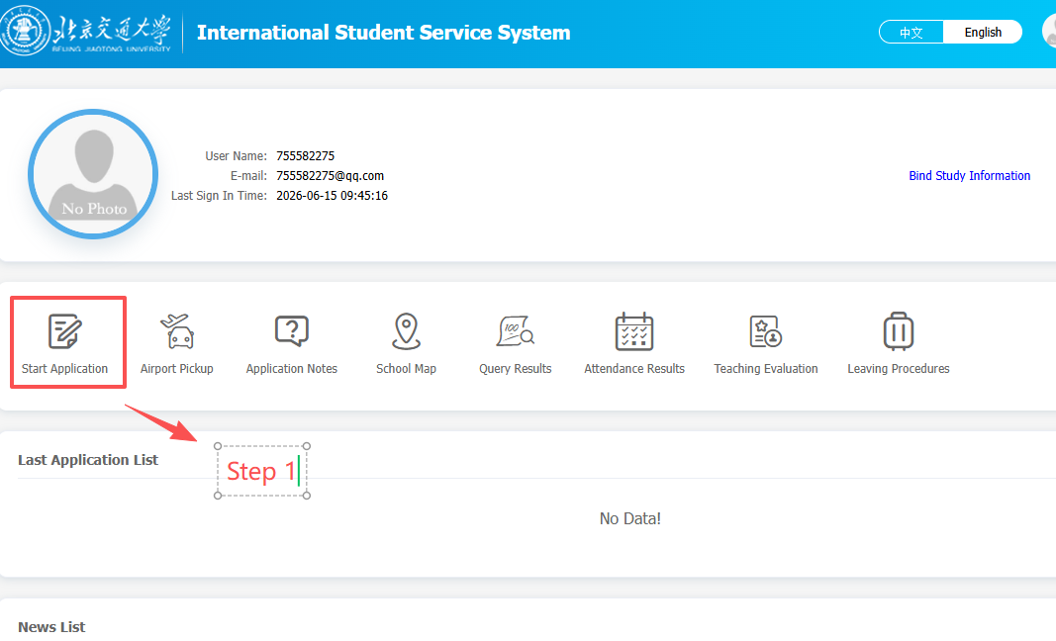

Slide 3
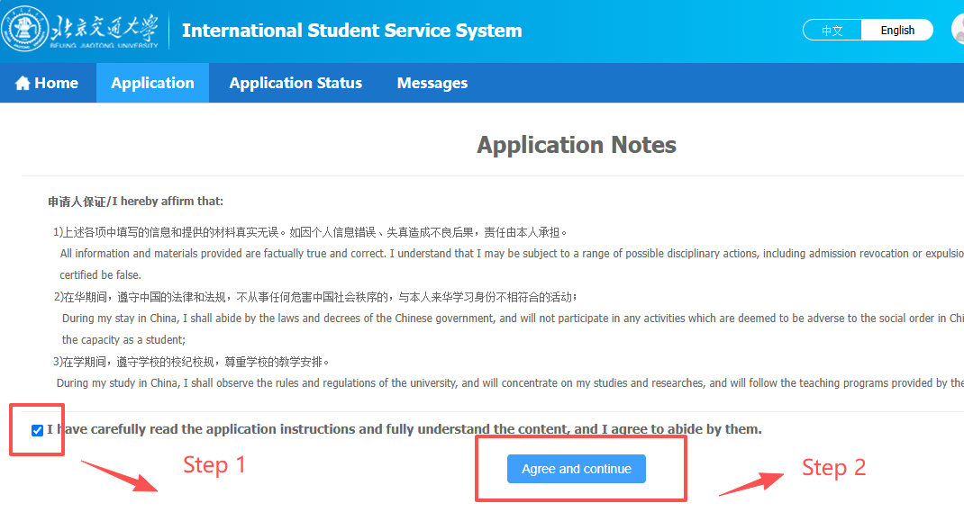

Slide 4
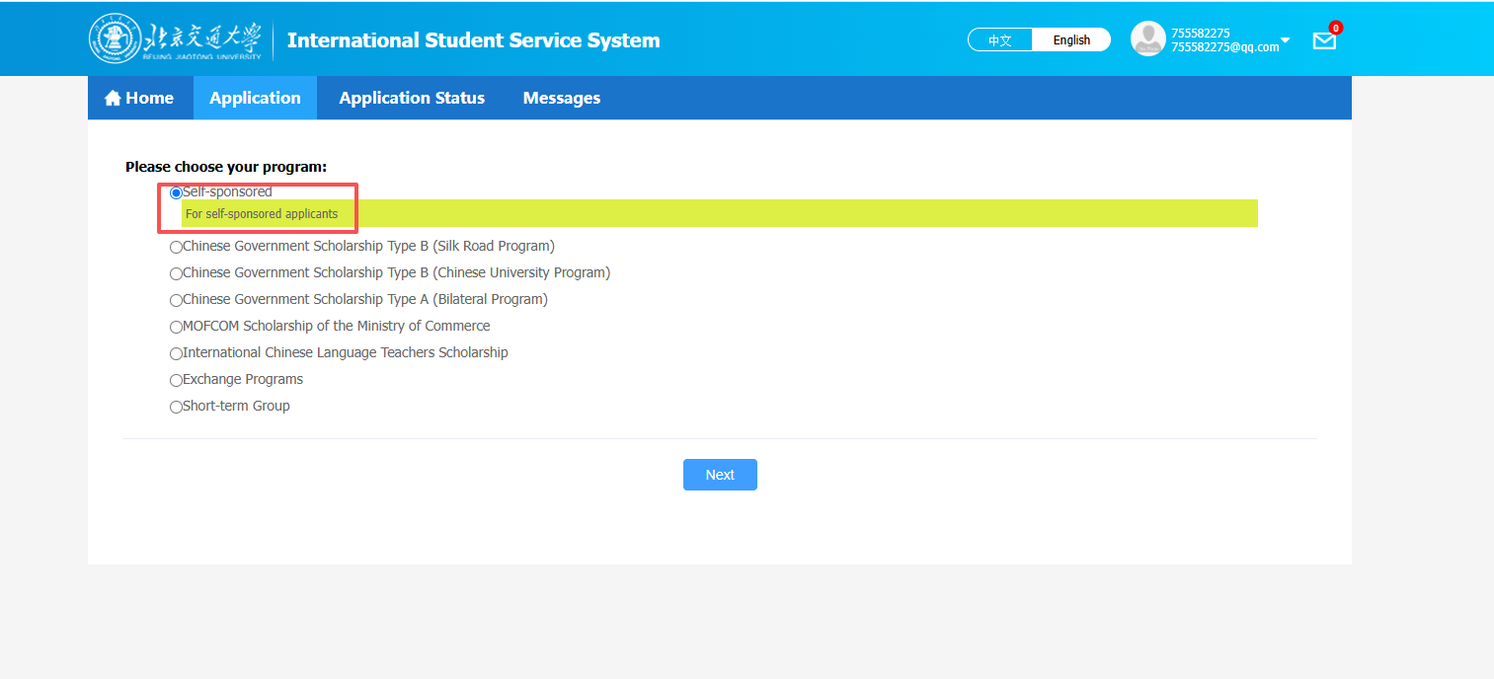
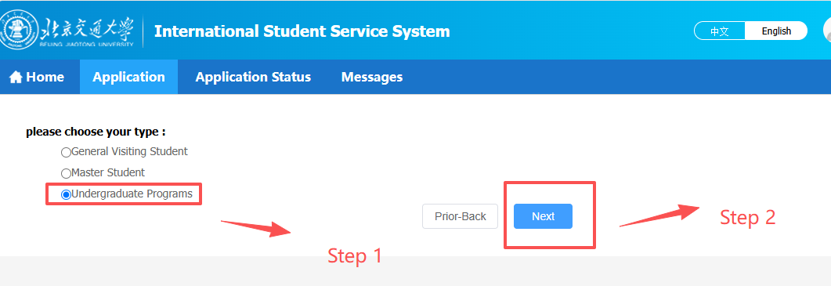

Slide 5
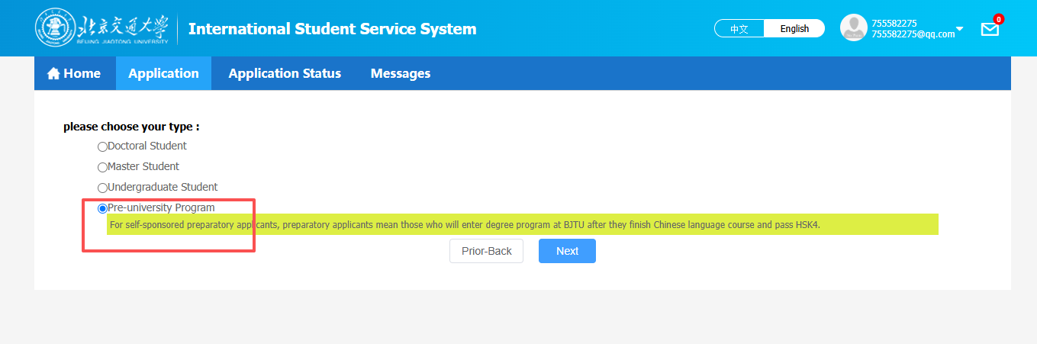

Slide 6
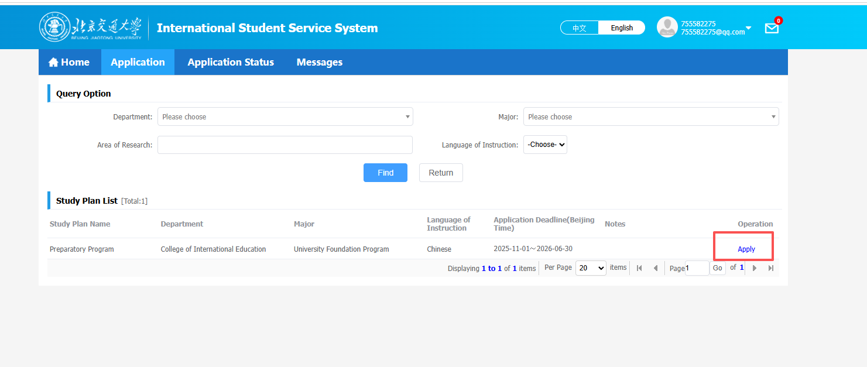

Slide 7
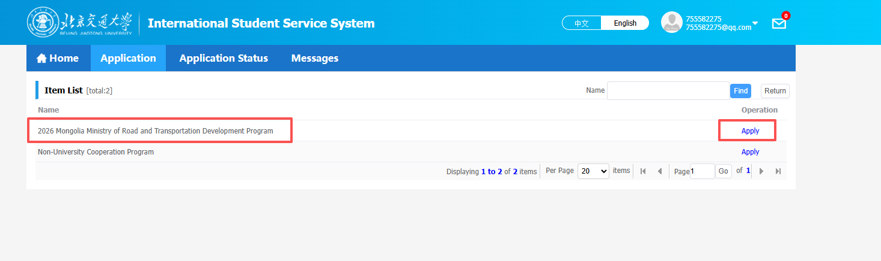

Slide 8
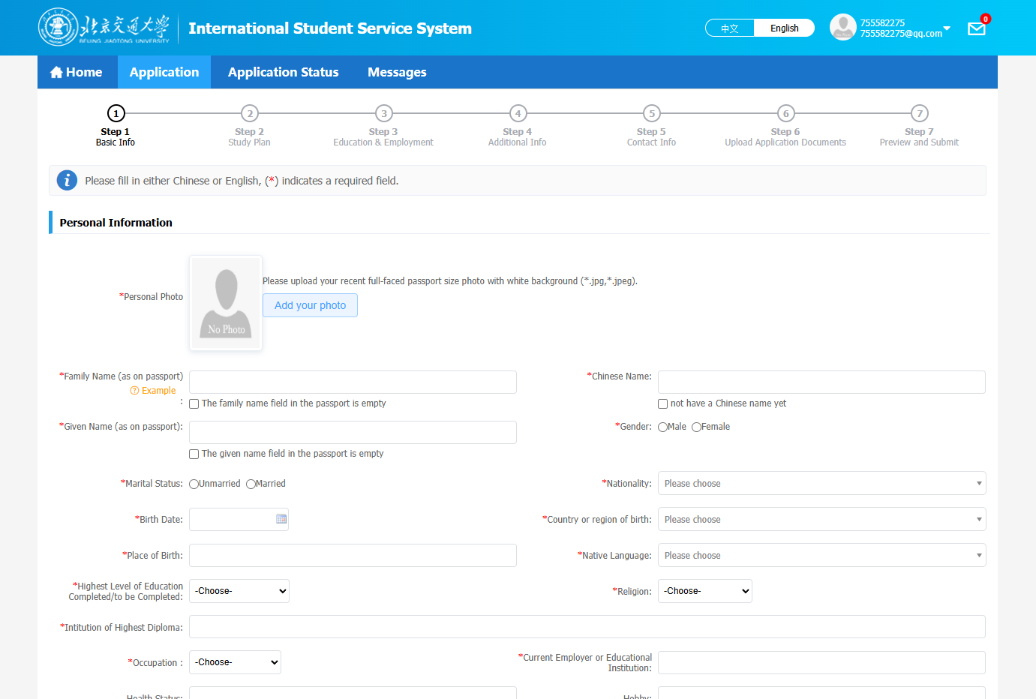

Slide 9
Documents List
 | DOCUMENT TYPE | NOTE
1 | Passport (Page with photo) | Please ensure that your passport is within the validity period.
2 | Study Certificate from Home University | Please provide the original document and Chinese/English translation.
3 | Transcripts of Records from Home University
4 | Physical Examination Record for Foreigner | Download at http://cie.bjtu.edu.cn/contentType/7.htm
5 | Certificate of No Criminal Record | An official certificate from the local public security authorities is required.
6 | The Valid Report of Chinese or English Language Proficiency Tests(HSK; For English Medium: IELTS or TOEFL) | Please upload your HSK level certificate, or Chinese study transcript.

Slide 10
CONTACT INFORMATION
TEL: +86-10-5168 5457 / +86-10-5168 5456
FAX: +86-10-5168 5258
QQ: 3176204588 WeChat: AdmissionBJTU
EMAIL: bjtuadmission@foxmail.com
WEBSITE
BJTU Home Page: http://www.bjtu.edu.cn
BJTU International Student Service System: http://bjtu.17gz.org
BJTU College of International Education Portal: http://cie.bjtu.edu.cn

